Slide 1
The Accounting Profession in Africa – State of Play and Prospects
Shahied Daniels
Chief Executive
South African Institute of Professional Accountants (SAIPA)

Slide 2
Introduction
Thanks for inviting me as CE of SAIPA to present a view on this very important topic.
Productivity optimisation by way of a constant stream of new technologies is rapidly transforming the Accountancy Profession. Today’s Professional Accountant should no longer be burdened by task-oriented projects. Thanks to dynamic technology, accounting software programs are becoming more automated and the role of the Professional Accountant is changing to that of a Business Advisor. Understandably, this requires new skill-sets, which include professional scepticism, judgment, and critical thinking.

Slide 3
What is Sustainable Business
Sustainable business has an inherently long-term time horizon. It is about creating the right conditions to sustain business success – for shareholders and other stakeholders today and in the future.
Sustainable business is about core operations – not peripheral activities. It requires looking ahead and planning with a long-term mindset. Delivering business and social value needs a strategic approach.
Sustainability includes: social issues (e.g. labour relations or human rights); environmental impacts (e.g. climate change or waste); economic (e.g. jobs and taxes); and governance considerations.
“Not limited to Climate Change only”

Slide 4
Although sustainability has become much of a buzz-word that for many is seen as merely finding ways of perpetuating the status quo, this is increasingly far removed from the current day reality.
In 1987 the Brundtland Commission set out what has become the most used definition:
Development that meets the needs of the present without compromising the ability of future generations to meet their own needs

Slide 6
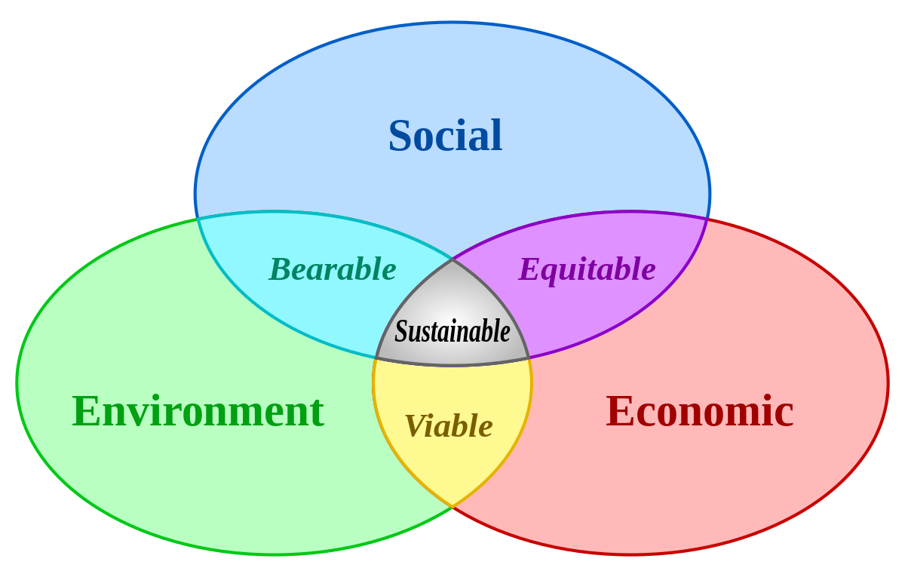

Slide 7

Why is Sustainable Business Important from and Accountancy Perspective
The external environment is rapidly changing, as are client needs, and the regulatory and investor requirements.
Organisations face material risks that could include energy prices, migration, climate change impacts, cyber-security, and corruption.
This necessitates a managed approach to assist them in dealing with the biggest risks, understanding long-term trends, and realising and responding to new opportunities more rapidly than competitors.

Slide 8
Developing a Digital Mindset
Information and Communication Technology (ICT) have developed so rapidly – into “Digital Transformation”, that this has led to our age being characterised as the information age. This digital transformation process has necessitated that organisations use modern cost and management accounting tools by way of integrated institutional information systems. Consequently, Digital competencies and or proficiencies have become one of the basic technical skills that accounting graduates should possess. To prepare their students for the requirements of working life, educational institutions need to include mastery of “Digital Proficiency” in accounting courses, programmes, degrees etc. Furthermore, they must be educated in the use of the data analytics for analysing masses of big data, data security and cybersecurity.

Slide 9
The Accountancy Profession has to keep up with the change in a world that is in the process of rapid digitalization. New technologies emerging in current accounting education are required to support the learning and development of Accountancy students.
The future Professional Accountants entering the age of digital transformation must be able to leverage the latest technology for establishing meaningful data connections, instead of indulging in mere operational analysis and making some inferences.

Slide 10
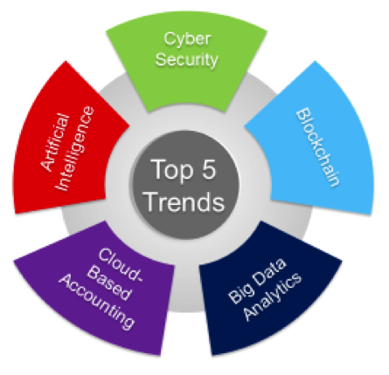
Top 5 Trends

Slide 11
Technology and the Modern-Day Professional Accountant
Technology advancements have enhanced the Professional Accountant’s ability to interpret data efficiently and effectively. Because they now have the ability to interpret the language of business with such ease, the Professional Accountant has become the most “Trusted Business Advisor” within and outside organisations.

Slide 12
The following technologies are greatly contributing to the new role of Professional Accountants:
Artificial intelligence (AI) and Robotics have, with extreme accuracy, automated complex and repetitive tasks and processes, thereby reducing operating costs whilst simultaneously improving accuracy.
Innovations and Tax Software are helping to improve accuracy whilst reducing margins of error, thereby helping organisations to avoid tax penalties and prevent issues with stakeholders. Furthermore, these technologies assist in streamlining audits, making them more efficient and effective.

Slide 13
Mobile / Cloud Accounting and related apps provide a bridge between Professional Accountants and their clients by allowing them to manage their business on the move. Invoices can be sent, receipts added, and expense claims sent from smartphones and tablets.
Social Media has become an essential tool for organisations wishing to engage with current and potential clients whilst simultaneously extending the reach of their brand. Furthermore, Professional Accountants are provided with a very valuable sales and marketing platform, which instantly connects them to current and potential clients.

Slide 14
Profession has moved far beyond processing transactions and preparing financial reports and taking an increasingly strategic role for forward-thinking businesses.
Virtual, augmented and mixed reality technologies will move to provide new ways to explore, analyze and share data, pioneering new process optimizations and connecting finance to strategic planning.
Blockchain as distributed ledger technologies will be in high demand for process development, auditing and records management, etc.

Slide 15
Accounting may become less about refining one's skill set through certifications and more about core competencies that grow over time, with a focus on lifelong education and skill development required to take on a complex, ever-changing business environment.
Unless Professional Accountants embrace the rapid advances in technology and Digital Transformation their relevance will quickly fade away. Without continuous reskilling and upskilling they will become anachronisms.

Slide 16
Whilst thinking about this crucially important topic, I was reminded of the following saying:
When an egg is broken from the outside life ends,
but when an egg is broken from the inside life begins.

Slide 17


Slide 18
Thank You

